Slide 1
Simple Algorithmic Ideas

Slide 2
Three classes of machine learning tasks
Supervised learning
Unsupervised learning
Reinforcement learning
In this session we will see very simple ideas that can be used for solving these classes of tasks.

Slide 3
Supervised Learning

Slide 4

Supervised Learning
X₁ | X₂ | X₃ | … | X_{n-2} | X_{n-1} | X_{n} | Y
x_{1,1} | x_{2,1} | x_{3,1} | … | x_{n-2,1} | x_{n-1,1} | x_{n,1} | y₁
x_{1,2} | x_{2,2} | x_{3,2} | … | x_{n-2,2} | x_{n-1,2} | x_{n,2} | y₂
. . . | . . . | . . . | … … … | . . . | . . . | . . .
x_{1,m-1} | x_{2,m-1} | x_{3,m-1} | … | x_{n-2,m-1} | x_{n-1,m-1} | x_{n,m-1} | y_{m-1}
x_{1,m} | x_{2,m} | x_{3,m} | … | x_{n-2,m} | x_{n-1,m} | x_{n,m} | y_{m}
$$\hat{Y}=f\left(X_{1},X_{2},…,X_{n}\right)$$

Slide 5
The look alike idea
Observations that have “similar” values of explaining features tend to have similar values of outcome.
What does it mean similar values of explaining features is not an easy question.

Slide 6
What does it mean similar outcome
In classification: similar = the same class label
In regression: similar = Low difference between the outcome values
Low square difference

Slide 7
K-Nearest Neighbors
When you want to predict or asses the outcome of a previously unseen observation, search for the K closest observation in your training set, and infer the outcome
In classification, we typically use voting
In regression we typically use averaging or medians

Slide 8
K-Nearest Neighbors
K=3
Email Length
Recipients

Slide 9
K-Nearest Neighbors
K-NN is a very simple idea. It has a lot of drawbacks, but it can be implemented, and provide reasonable predictions.
It is a supervised learning algorithm that actually have no learning step (you don’t have to prepare anything – simple use your historic data).
This seemingly advantage comes with a lot of drawbacks.

Slide 10
K-Nearest Neighbors
K is a parameter of the algorithm. A way for you to control its operation.
Small K: You base your prediction / assessment only on the most close observations (which might be noisy)
Large K: You allow more far observation to affect your decision (lest prune to noise but also less sensitive to the real patterns).
Total result variability = bias + variance
The objective is to learn the bias without being distracted by the variance

Slide 11
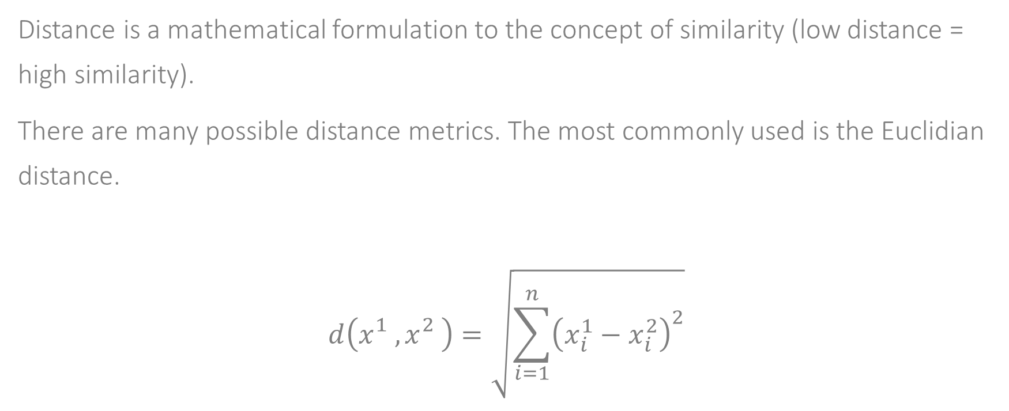
K-Nearest Neighbors
Distance is a mathematical formulation to the concept of similarity (low distance = high similarity).
There are many possible distance metrics. The most commonly used is the Euclidian distance.
$$d\left(x_{}^{1},x_{}^{2}\right)=\sqrt{\sum_{i=1}^{n}{{\left(x_{i}^{1}−x_{i}^{2}\right)}^{2}}}$$

Slide 12
K-Nearest Neighbors
Does Euclidian distance really means similarity?
How do we combine features of different scales?

Slide 13
K-Nearest Neighbors
K-NN have very bad computational characteristics: for each new sample that requires predictions, the algorithm runs over the entire training set.

Slide 14
Unsupervised Learning

Slide 15
Unsupervised Learning
In unsupervised learning there is no specific outcome that we want to predict.
It is a generic class of machine learning problems.
A common case of unsupervised learning is the case of clustering (or cluster analysis).

Slide 16
Clustering
Given a set of data samples, create K groups of samples, so that samples that share a group will be similar to each other and samples in different groups will be different from each other.
Potential use cases:
Market segmentation
Data reduction \ simplicity
Outlier detection
Data exploration

Slide 17
K-Means
K-Means is a simple approach to clustering

Slide 18
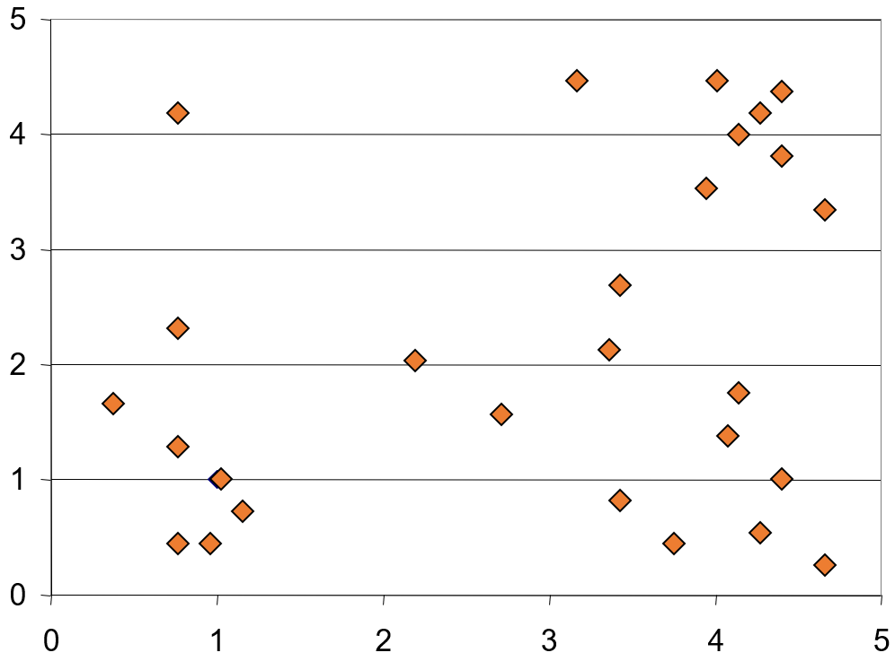
K-Means

Slide 19
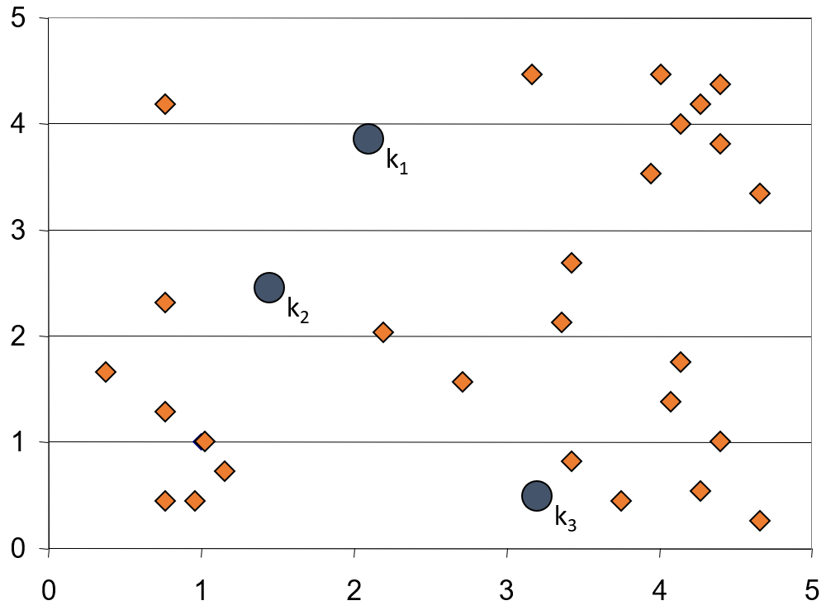
K-Means

Slide 20
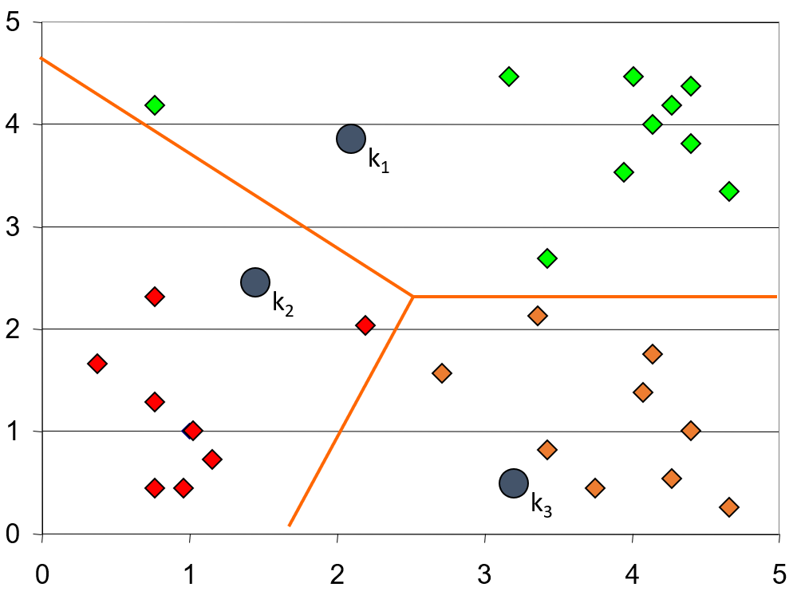
K-Means

Slide 21
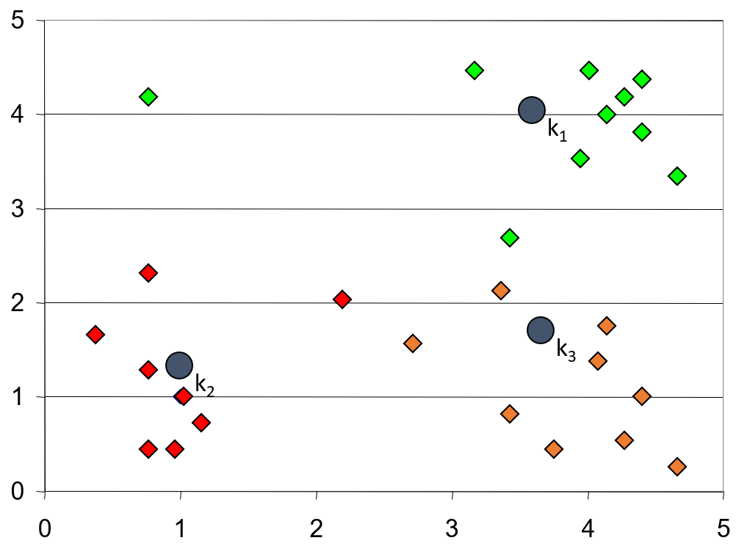
K-Means

Slide 22
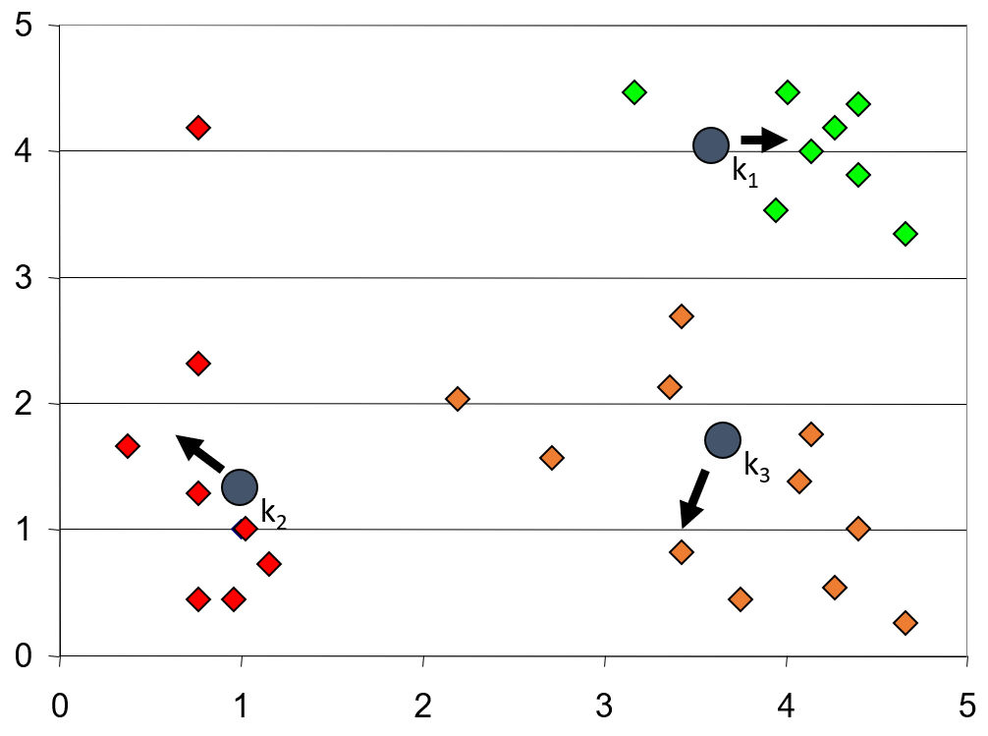
K-Means

Slide 23
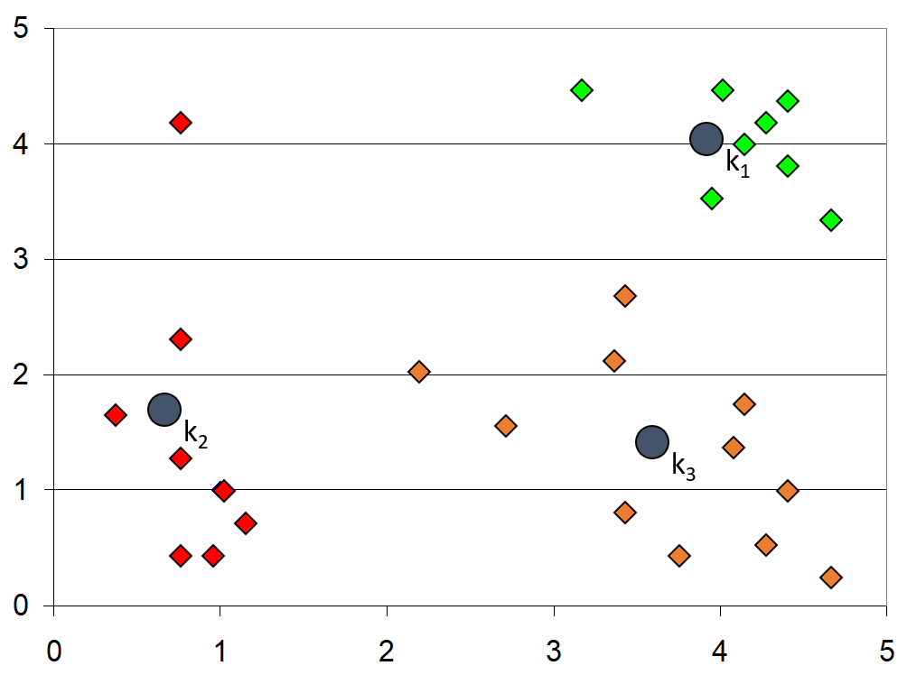
K-Means

Slide 24
Reinforcement Learning

Slide 25
Reinforcement Learning
Objective: train an autonomous agent that will know how to best react to situations. The agent should learn from trial and error (since no one knows in advance what is the best reaction to each and every possible situation)

Slide 26
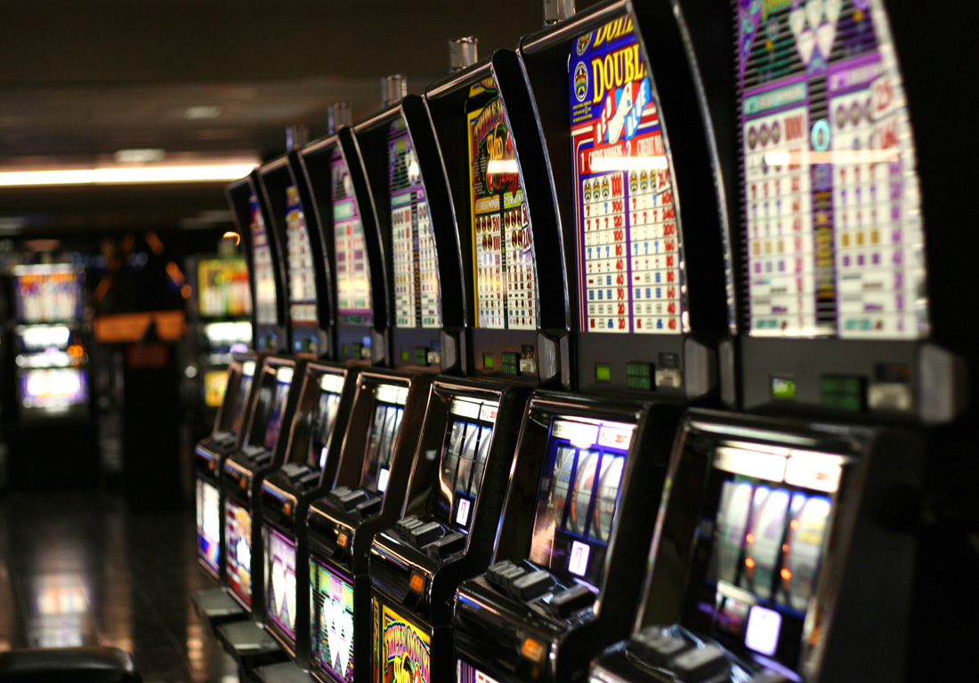
K-Armed Bandit

Slide 27
Reinforcement Learning
Q₁ = 10
Q₂ = 10
Q₃ = 10
…
Q_{K} = 10

Slide 28

Reinforcement Learning
Select arm a, and obtain reward r
$$Q_{a}≔\left(1−α\right)∙Q_{a}+α∙r$$
$Q_{a}$ converges to the real expected value of arm a under reasonable conditions.

Slide 29
Simple Algorithmic Ideas

